Slide 1



M I S S I O N
K A L A M

Slide 2

Cognitive Approach Towards our Problem Statement
Detection
Differentiation
Classification
Modelling
Alerting

Slide 3
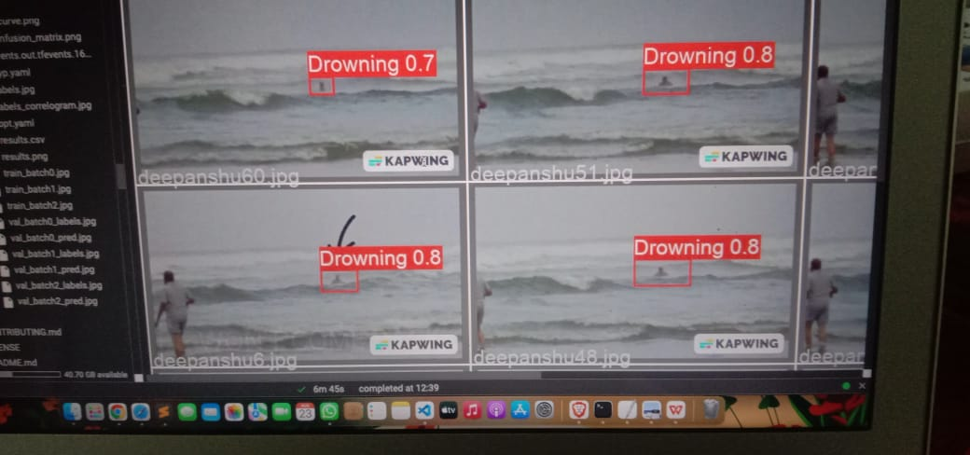
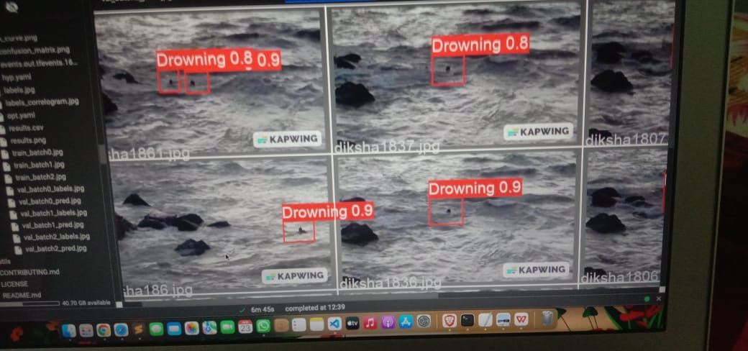
DETECTION

Slide 4
Our Model is able to differentiate between different Abstract Data like Swimming,Drowning,Surfing, Floating, Man with Jacket etc
DIFFERENTIATION

Slide 5
As of now, Our Model can classify between 2 labels Swimming and Drowning.
CLASSIFICATION

Slide 6
Demonstration of Working Model Using Yolo V5 (You Look only Once) Algorithm.
We are working on some Calculations like measuring distance from Watchtower to Drowning people
MODELLING

Slide 7
Improvements Based on Suggestions
Demonstration (Distance Derivation)
False Alarms
Another Approach other than Image Detection Thermal Detection

Slide 8
False Alarms
“False Alarms are critical conditions that cause Inconvenience to Lifeguards”
Approach -
Use human intervention as alert model
AI Based System for monitoring
Team will detect the danger zone
Zoom in the zone to detect the actual activity.

Slide 9
Thermal Detection
“Boon to False Alarms as Well”
Observing the physical properties of the
swimmer
Oxygen level
Blood Pressure
HeartBeat
High BP is associated with change in Body temperature.
Detection using thermal cameras.

Slide 10
ALERTS
Sending Data in the form of an API to LifeGuards and and Coordinates to our JellyBots
Assuming JellyBots to be Wireless Sensor Nodes can help transferring data more efficiently

Slide 11
Thankyou

